Slide 1
NLP for Social Good
Splash 2018

Slide 2
What is it?
…and why do we care?

Slide 3
What is “NLP”?
“Natural-language processing (NLP) is an area of computer science and artificial intelligence concerned with the interactions between computers and human (natural) languages, in particular how to program computers to fruitfully process large amounts of natural language data.”
- Wikipedia
https://en.wikipedia.org/wiki/Natural-language_processing

Slide 4
What is “NLP”?
“Natural-language processing (NLP) is an area of computer science and artificial intelligence concerned with the interactions between computers and human (natural) languages, in particular how to program computers to fruitfully process large amounts of natural language data.”
- Wikipedia
https://en.wikipedia.org/wiki/Natural-language_processing

Slide 5
What is “NLP”?
“Natural-language processing (NLP) is an area of computer science and artificial intelligence concerned with the interactions between computers and human (natural) languages, in particular how to program computers to fruitfully process large amounts of natural language data.”
- Wikipedia
https://en.wikipedia.org/wiki/Natural-language_processing

Slide 6
What is “NLP”?
“Natural-language processing (NLP) is an area of computer science and artificial intelligence concerned with the interactions between computers and human (natural) languages, in particular how to program computers to fruitfully process large amounts of natural language data.”
- Wikipedia
https://en.wikipedia.org/wiki/Natural-language_processing

Slide 7
What is “NLP”?
“Natural-language processing (NLP) is an area of computer science and artificial intelligence concerned with the interactions between computers and human (natural) languages, in particular how to program computers to fruitfully process large amounts of natural language data.”
- Wikipedia
https://en.wikipedia.org/wiki/Natural-language_processing

Slide 8
Why do we care?

Slide 9
“Analysts at Gartner (gated) estimate that upward of 80% of enterprise data today is unstructured.”
https://www.forbes.com/sites/forbestechcouncil/2017/06/05/the-big-unstructured-data-problem/#13919ec4493a

Slide 10
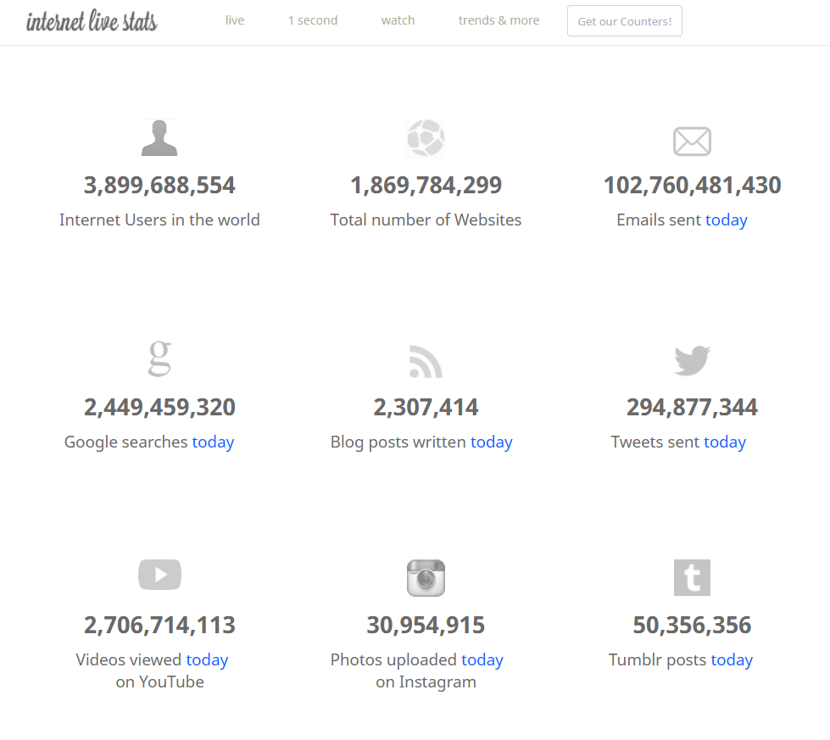
http://www.internetlivestats.com/

Slide 11
What can we work on?

Slide 12
What is “NLP”?
“Natural-language processing (NLP) is an area of computer science and artificial intelligence concerned with the interactions between computers and human (natural) languages, in particular how to program computers to fruitfully process large amounts of natural language data.
Challenges in natural-language processing frequently involve speech recognition, natural-language understanding, and natural-language generation.”
- Wikipedia
https://en.wikipedia.org/wiki/Natural-language_processing

Slide 13
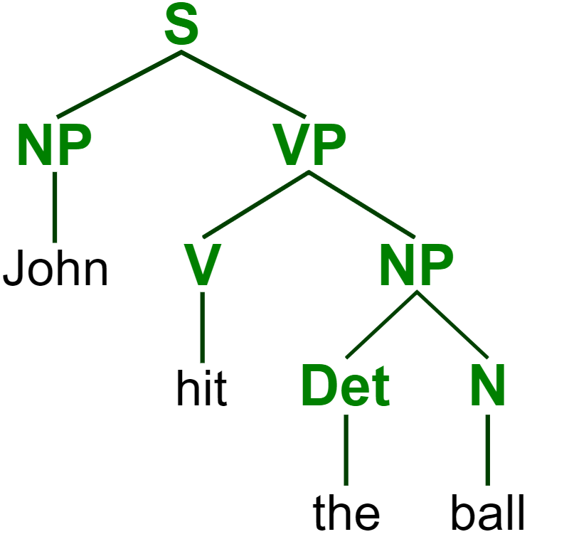
https://commons.wikimedia.org/wiki/File:ParseTree.svg
Notes:
Parse tree: sentence; noun phrase, verb phrase; verb, determiner, noun

Slide 14
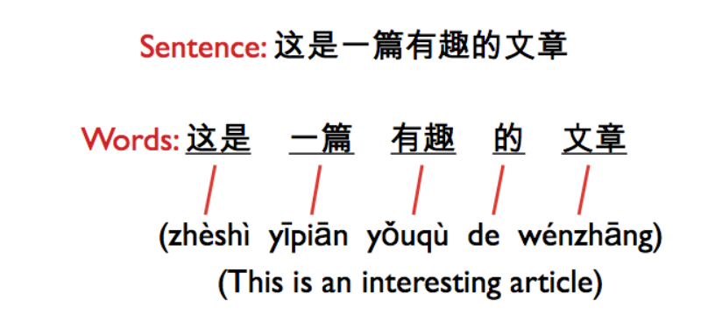
http://iconictranslation.com/2014/10/language-challenge-7-chinese/

Slide 15
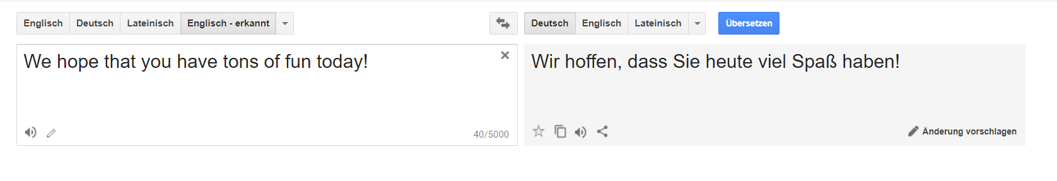
translate.google.com

Slide 16
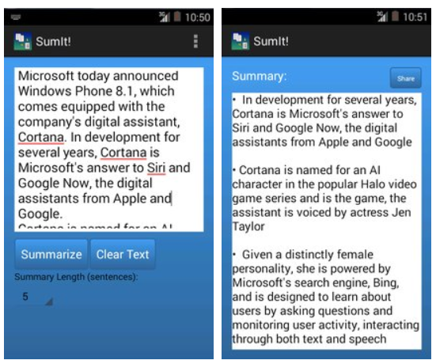
https://apkpure.com/sumit-text-summarization/com.karimo.sumit_final

Slide 17
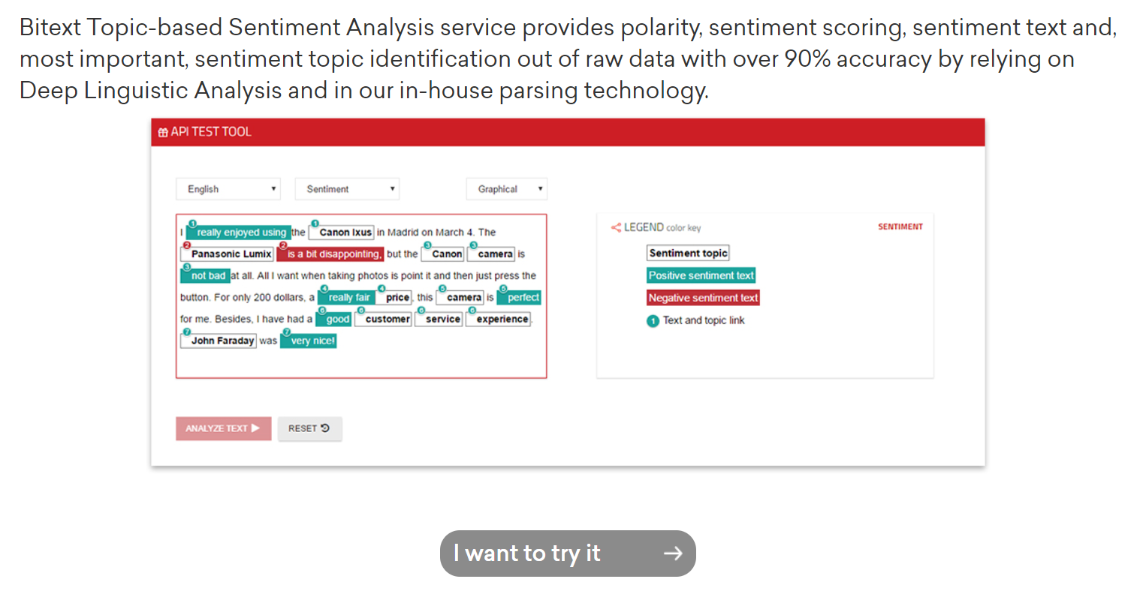
https://www.bitext.com/sentiment-analysis/

Slide 18
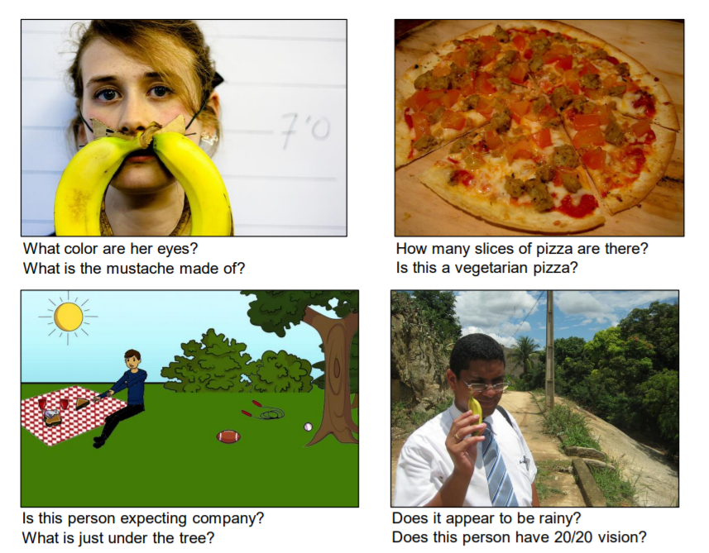
A. Agrawal et al., “VQA: Visual Question Answering,” arXiv:1505.00468 [cs], May 2015.

Slide 19

https://matlab1.com/support-vector-machine-speech-recognition/

Slide 20
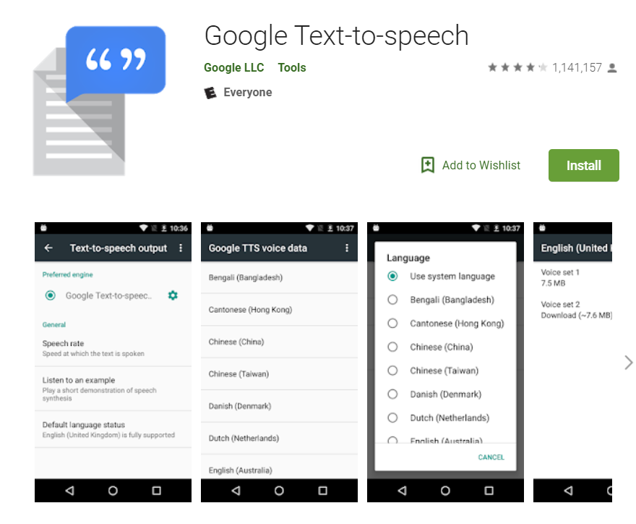
https://play.google.com/store/apps/details?id=com.google.android.tts&hl=en_US

Slide 21
What makes it difficult?

Slide 22
What is “NLP”?
“Natural-language processing (NLP) is an area of computer science and artificial intelligence concerned with the interactions between computers and human (natural) languages, in particular how to program computers to fruitfully process large amounts of natural language data.”
- Wikipedia
https://en.wikipedia.org/wiki/Natural-language_processing

Slide 23
translate.google.com

Slide 24

https://www.ecenglish.com/en/social/blog/ec-central/2015/11/23/vocab-review-homophones

Slide 25
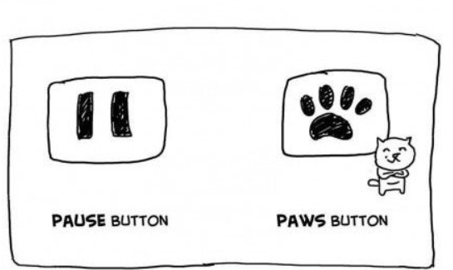
https://i.pinimg.com/originals/0a/92/15/0a921501fa2c6ad60f2e7cde0c8e90a4.jpg

Slide 26
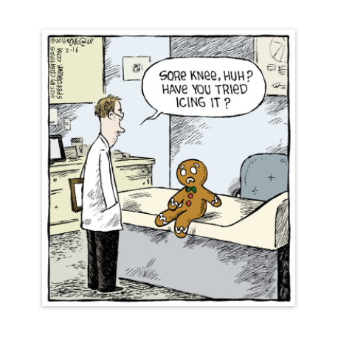
https://www.creators.com/read/speed-bump/02/16/165650

Slide 27
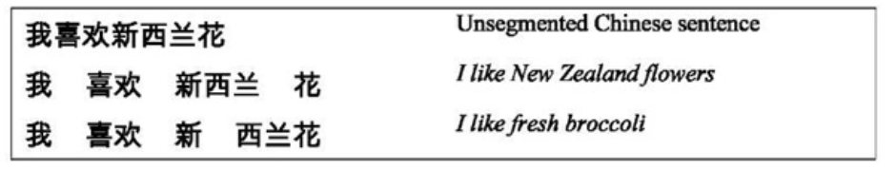
http://what-when-how.com/how-to-build-a-digital-library/word-segmentation-and-sorting-digital-library/
Notes:
Segmentation

Slide 28

http://onthesannyside.blogspot.com/2015/08/fun-with-dangling-modifiers.html

Slide 29

http://explosm.net/comics/1206

Slide 30

https://imgur.com/r/thesimpsons/1ZKxV5O
Notes:
Ambiguous sentences: https://www.teatime-mag.com/magazines/wp-content/themes/tt/print/teatime61/print.pdf

Slide 31
How does it work?
…and how can we make it work?

Slide 32
Hangman
Why did you guess the letters in the order that you did?

Slide 33
Human Learning
Statistical learning: learning how to understand and speak language by analyzing how others speak
Word frequencies, word order, recurring grammatical patterns
Segmentation: 8-month-old infants react differently to pseudowords than non-words after 2 minutes of exposure to nonsense speech
Examples:
“Powerful tea”
“Strong rain”
“
http://akenney.github.io/mind-cascade/language/

Slide 34
Natural Language Understanding
Natural Language Generation
Break speech down into letter / sound chunks
Compare to recorded phonemes and pick likeliest combinations
Thank back to Hangman
Garden path sentences
Get the important question words
Check the internet for response to question (or perform an action)
Form sentence around answer information using grammatical rules
Use speech to text!

Slide 35
Representing Words
Computers can model human statistical learning
“ “You shall know a word by the company it keeps.” -- John Rupert Firth
Given one word, what others are most likely to occur around it?

Slide 36
Representing Words
Represent words as vectors
Vectors are like coordinates in higher dimensions
Like an arrow in multidimensional space
These vectors are created by attempting to predict the contexts in which a given word is likely to appear
The spatial relationships between word vectors often contain meaning about words!
𝖶("𝗉𝖺𝗂𝗋")=(𝟢.𝟤,−𝟢.𝟦,𝟢.𝟩,...)
𝖶("𝗉𝖾𝖺𝗋")=(𝟢.𝟢,−𝟢.𝟣,𝟢.𝟣,...)
https://mathinsight.org/vectors_cartesian_coordinates_2d_3d
http://sanjaymeena.io/tech/word-embeddings/

Slide 37
Word Patterns
The computer doesn’t know anything about the meaning of the words at all, but some interesting patterns emerge…
Words that have similar meanings are usually very close in space
http://suriyadeepan.github.io/2016-06-28-easy-seq2seq/

Slide 38
Word Patterns
Words with parallel relationships have matching spatial relationships
http://sanjaymeena.io/tech/word-embeddings/

Slide 39
Cool Pattern: Vector Math
Analogies
King is to Man as Queen is to….
(King – Man) = (Queen – Woman)
Just based on solving for closest vector (minimum distance), we can get 60% accuracy at solving analogies
Machine learning is NOT PERFECT, there is always some degree of error
https://blogs.mathworks.com/loren/2017/09/21/math-with-words-word-embeddings-with-matlab-and-text-analytics-toolbox/

Slide 40
Cool Pattern: Translation Similarity
Same-meaning words tend to have very similar vectors across languages
Comparing these “language spaces” helps us perform translation
https://deeplearning4j.org/word2vec.html

Slide 41
Where do we use it?
…and how do we use it?

Slide 42
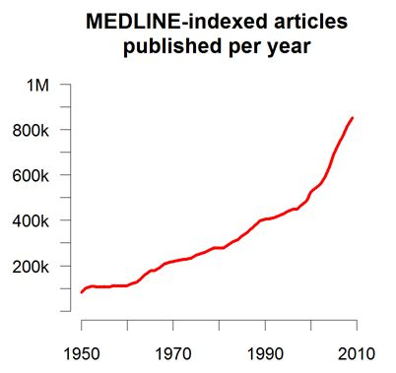

Medicine
More complete and accurate patient records – computer assisted coding

Slide 43
Medicine
More complete and accurate patient records – computer assisted coding
Efficiency gains: doctors can dictate their notes

Slide 44
Medicine
More complete and accurate patient records – computer assisted coding
Efficiency gains: doctors can dictate their notes
Clinical decision support: IBM Watson can learn from entirety of Medline literature; impossible for doctors to read even a fraction of this

Slide 45
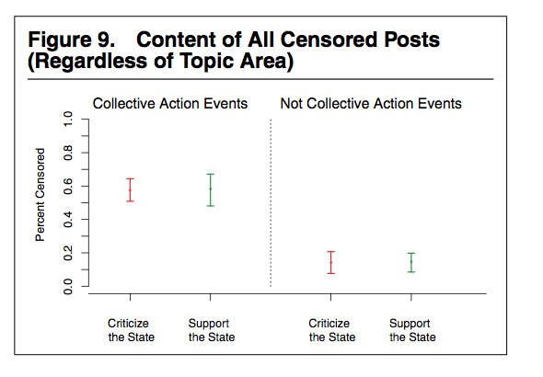
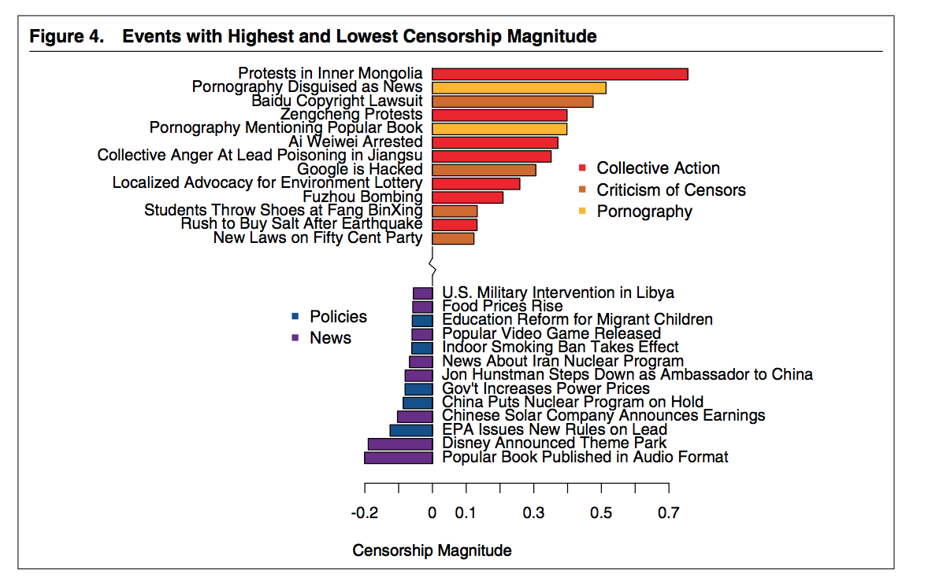
Censorship in China
King et al. 2013

Slide 46
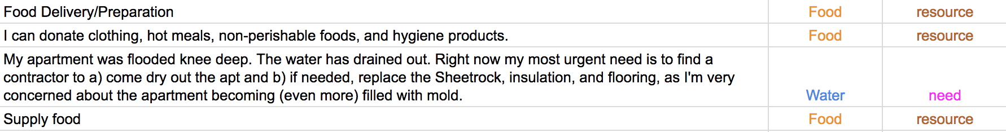
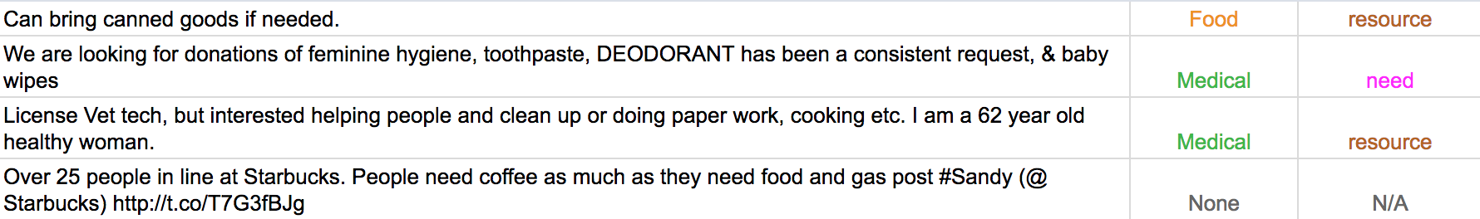
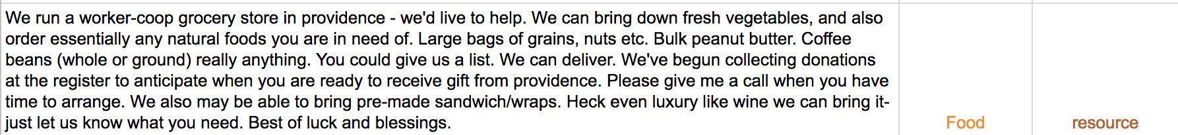
Disaster Relief and Resource Allocation - Twitter

Slide 47
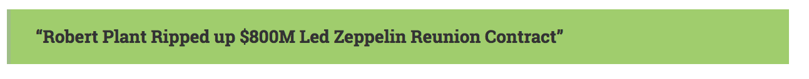
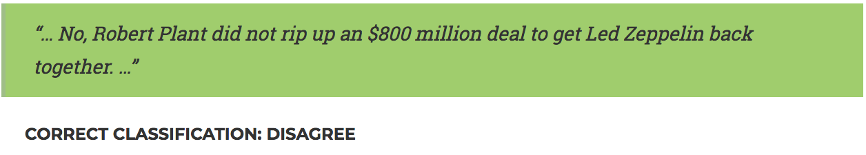
Fake News Challenge
Headline:
Claims:
Goal: train computer to recognize claims associated with headline as IN AGREEMENT, IN DISAGREEMENT, RELATED or UNRELATED

Slide 48
Fake News Challenge
Headline:
Claims:
Goal: train computer to recognize claims associated with headline as IN AGREEMENT, IN DISAGREEMENT, RELATED or UNRELATED

Slide 49
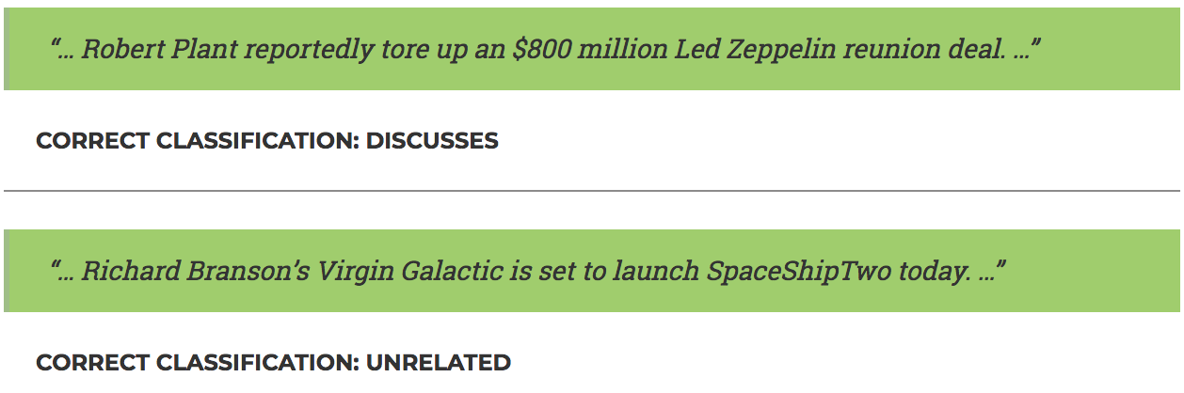
Fake News Challenge
Headline:
Claims:
Goal: train computer to recognize claims associated with headline as IN AGREEMENT, IN DISAGREEMENT, RELATED or UNRELATED

Slide 50
Fake News Challenge
Headline:
Claims:
Goal: train computer to recognize claims associated with headline as IN AGREEMENT, IN DISAGREEMENT, RELATED or UNRELATED

Slide 51
What else could we do?
…and what should we do?

Slide 52
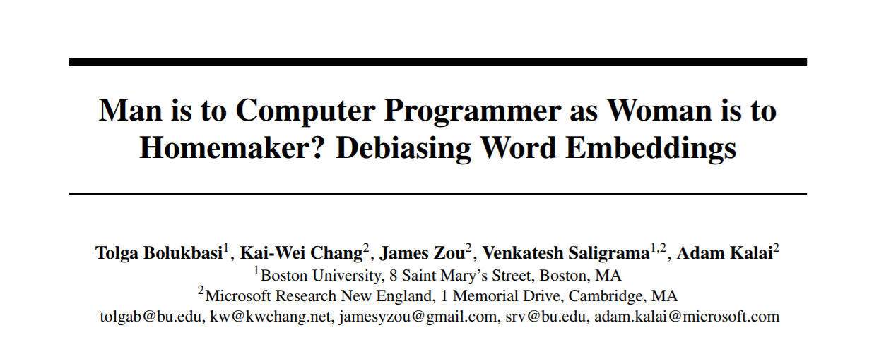
https://papers.nips.cc/paper/6228-man-is-to-computer-programmer-as-woman-is-to-homemaker-debiasing-word-embeddings.pdf

Slide 53
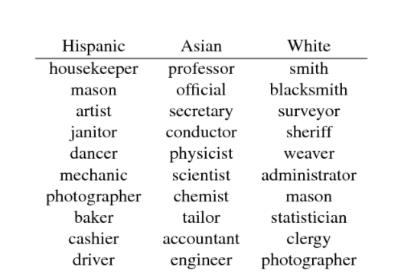
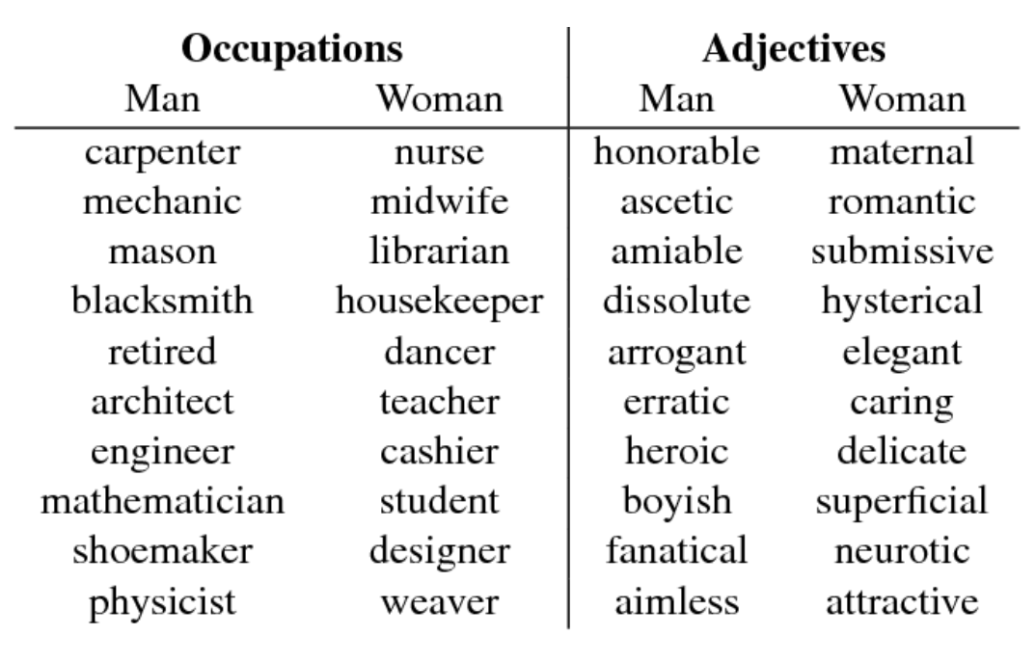
https://www.semanticscholar.org/paper/Word-Embeddings-Quantify-100-Years-of-Gender-and-Garg-Schiebinger/56e8985fa61037662650803d48177d752e9ce557
Notes:
“For contemporary snapshot analysis, we use the standard Google News word2vec Vectors trained on the Google News Dataset”
“We adapt the relative norm distance in Equation (5) for three groups. For each group, we compare the its norm bias with the average bias of the other groups, i.e. bias(group 1)=∑w[12(∥w−v2∥+∥w−v3∥)−∥w−v1∥]. This method can lead to the same occupation being highly ranked for multiple groups, such as happens for mason.”

Slide 54
What can we do in the future?
Notes:
Bias, HCI, benefits/risks

Slide 55
Questions?
…and answers?

